Slide 1

Android Development Course
Course ID
231134500
Student Name
Niv Arad
Student ID
KanPlan
316080035

Slide 2
01
02
Goal
Similar Applications
KanPlan is an Android app that empowers users to effortlessly manage products and projects. With Kanban templates akin to Trello, streamline tasks, visualize workflow stages, and collaborate seamlessly
Trello
Asana
JIRA
Monday
03
Personal Need
I work at the cyber unit in Lahav 433 , a place with a lot of bureaucracy ,so for the moment we don’t use any of the famous tools at the market . I want to try to develop something that will fit our needs for the moment

Slide 3
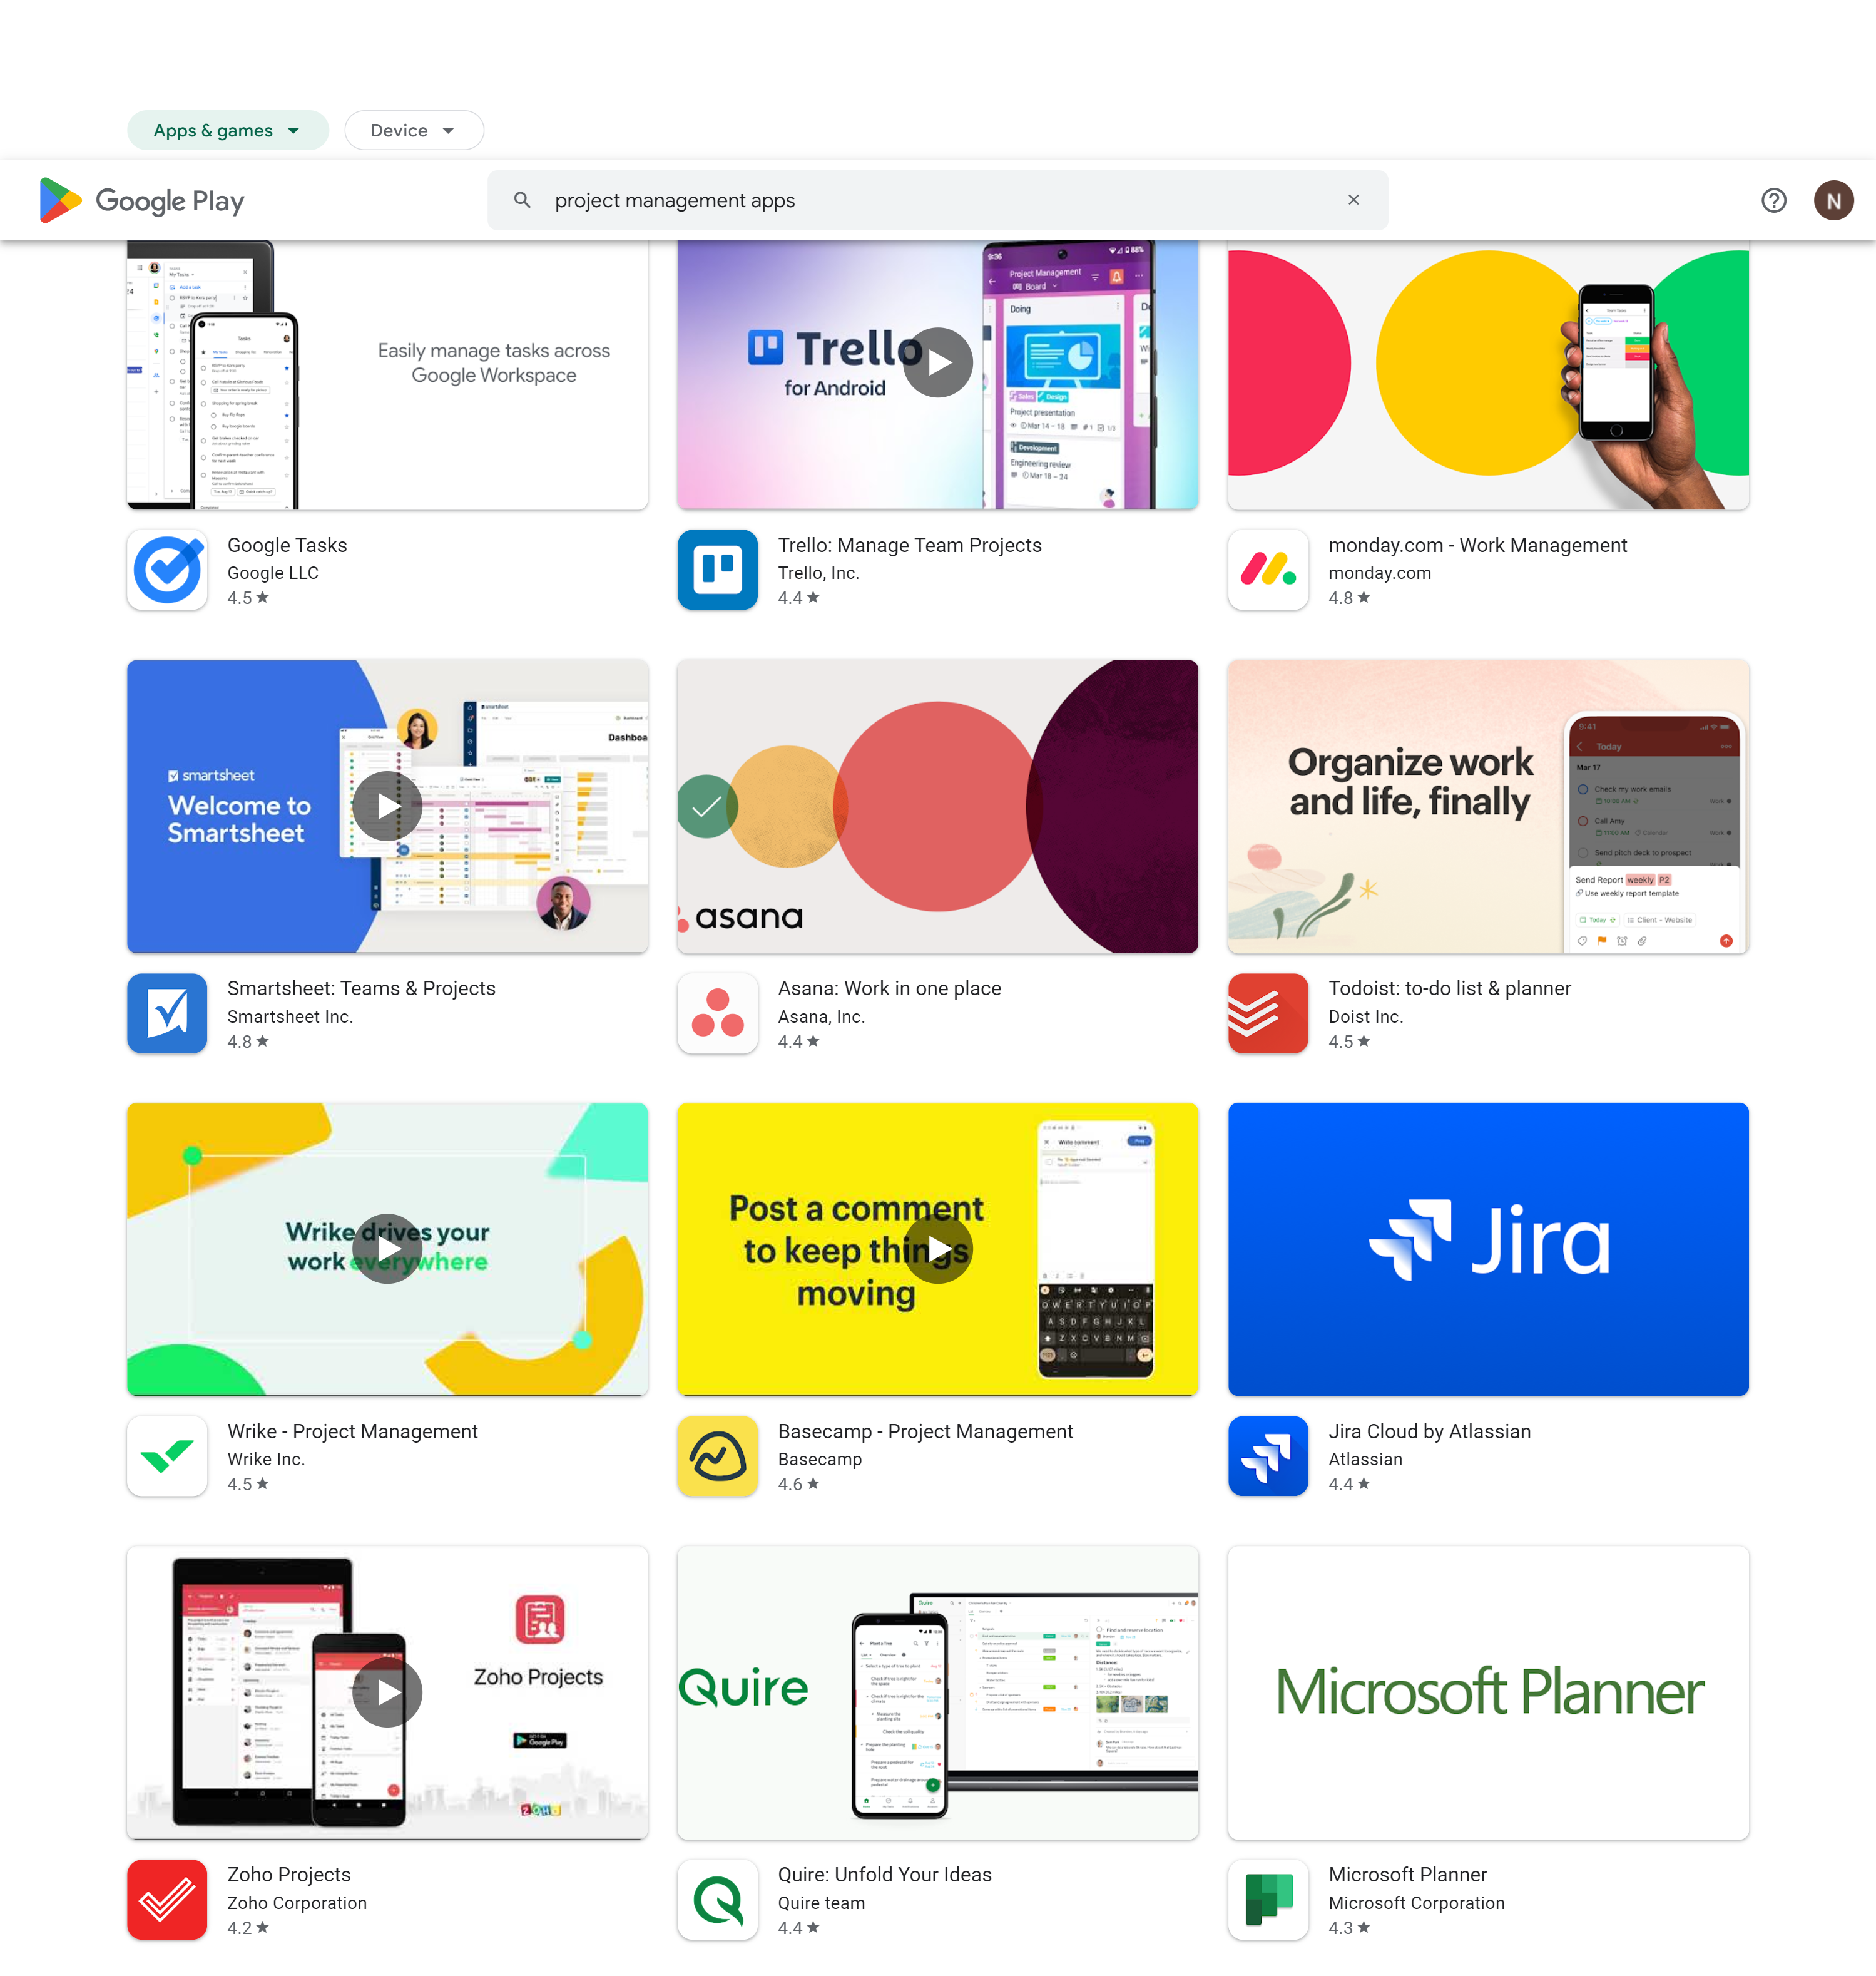
Market Research
There are many similar application Search Keywords:
Project Managements
Kanban
Work flow
Best: Trello with 10M+ downloads

Slide 4
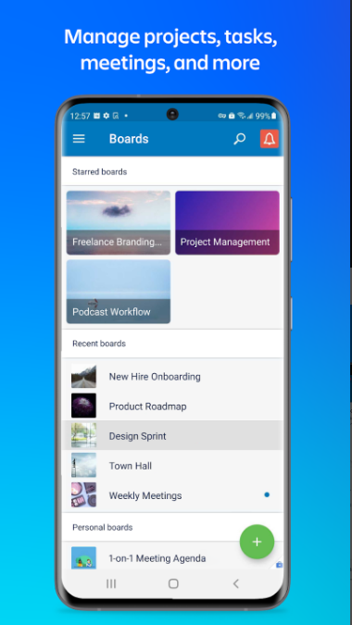
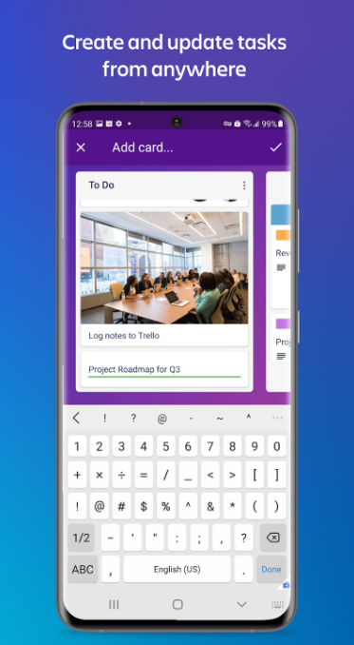
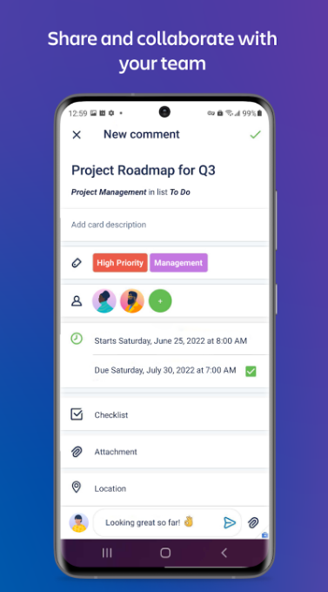
Trello Information
Trello
Released on 08.12
Last updated on 04.23
Downloads 10M +
Rating 4.4 average of 117k reviews
Subscription Purchases : 5$-17.5$ monthly

Slide 5
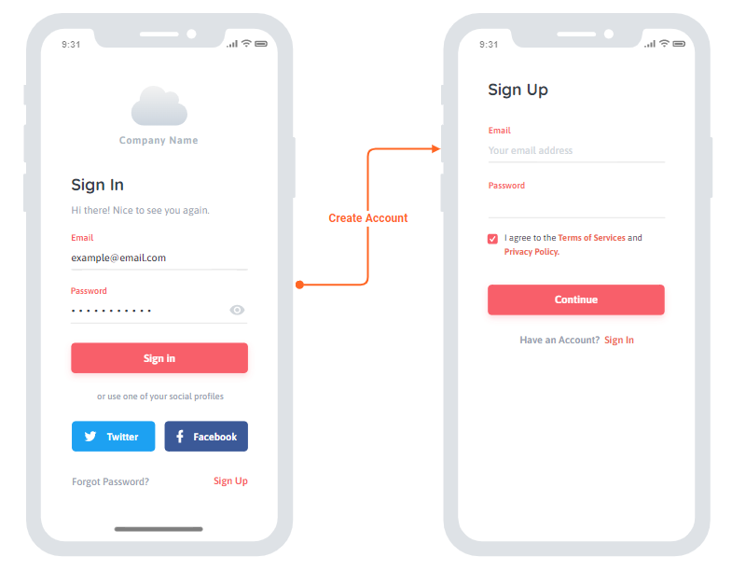
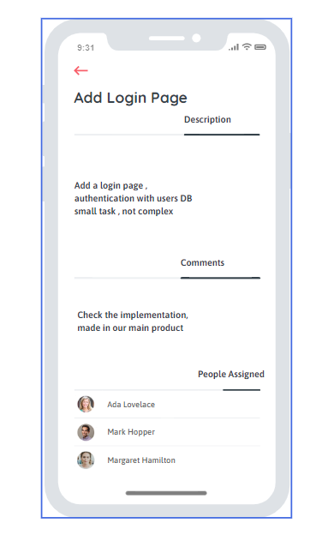
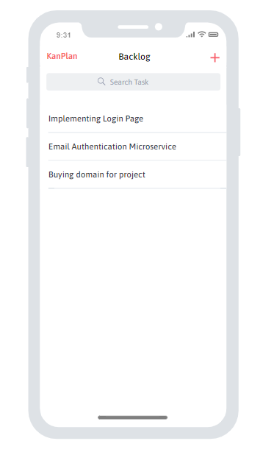
KanPlan –Mock up

Slide 6
KanPlan Features
Login with mail
Creating Taks
Assignees for taks
Adding comments for taks
Inviting people with mail
Move taks to other kanbans
KanPlan

Slide 7
KanPlan server’s uses
Server uses:
Firebase auth the manage users
Creating Products
Managing task between teammates
KanPlan

